Slide 1
Automating Email Threat Detection
By Josh Cox

Slide 2
Technical Background
Why I Chose This
I Chose this project because phishing is one of the most common cybersecurity threats, and detecting it efficiently is essential.
Research Steps
Investigated common phishing tactics and email patterns (e.g., misleading senders, suspicious links).
Explored Python libraries (IMAP, email parsing) to analyze email content.
Developed a script to detect phishing emails using keywords and sender patterns.

Slide 3
Tools & Technologies
Linux
Imap(Internet Messaging Access Protocol)
Crontab
Python3
Gophish(failed)
Nano
Used in this Project

Slide 4
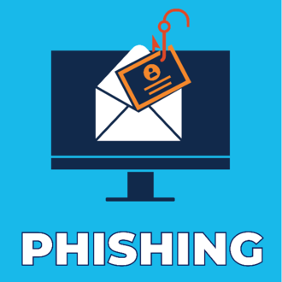


Scope of Project
Automated Phishing Detection: Using IMAP with a Python script to identify phishing emails (originally planned to use GoPhish)
Scheduled Scans: Crontab runs the script daily at 11:45 AM
Detection Focus: Identifying common phishing tactics, including suspicious keywords and links

Slide 5
Steps to be Demonstrated
Show Sent emails: Display both regular and phishing emails on gmail
Show the Python Script: Open the nano file that contains the python script.
Run the Python Script: Demonstrate how to run the python script using Python3
Set up Crontab: After the script is complete, run crontab -e and show the cron expression that schedules the script to run daily at 11:45 AM

Slide 6

The Walkthrough

Slide 7
Success/Failures of the Attack
Failures
GoPhish failed due to restrictions on SMTP traffic by Gmail and Outlook
Us of VM, made it more problematic with Gophish.
"No handshake made" error and prevented the phishing campaign from working
Successes
The IMAP and Python script functioned as intended.
The script successfully scanned the inbox and detected potential phishing attacks.
The Crontab scheduling was set up without errors and ran as expected.

Slide 8
Benefits
Minimal Resource Investment: Automated system that reduces manual labor and allows teams to focus on higher-priority security tasks.
Scalable: Easily adaptable to larger systems, with more time, knowledge and resources.
Cost-Effective: A lower-cost solution to enhance phishing detection without investing in expensive tools.
Training Opportunities: Security teams can use the data gathered from the script to run training sessions

Slide 9
Thank you

